Slide 1
Module 5 Week 1 – Neo4j

Slide 2
Neo4j Roadmap
Week 1
Introduction to Graph Databases
Graph Databases vs RDBMS
Property Graph Model
Operations on Graphs
When to use/not to use graph databases
Introduction to Neo4j
Neo4j Data Model
Intro to Cypher
Lab 1

Slide 3
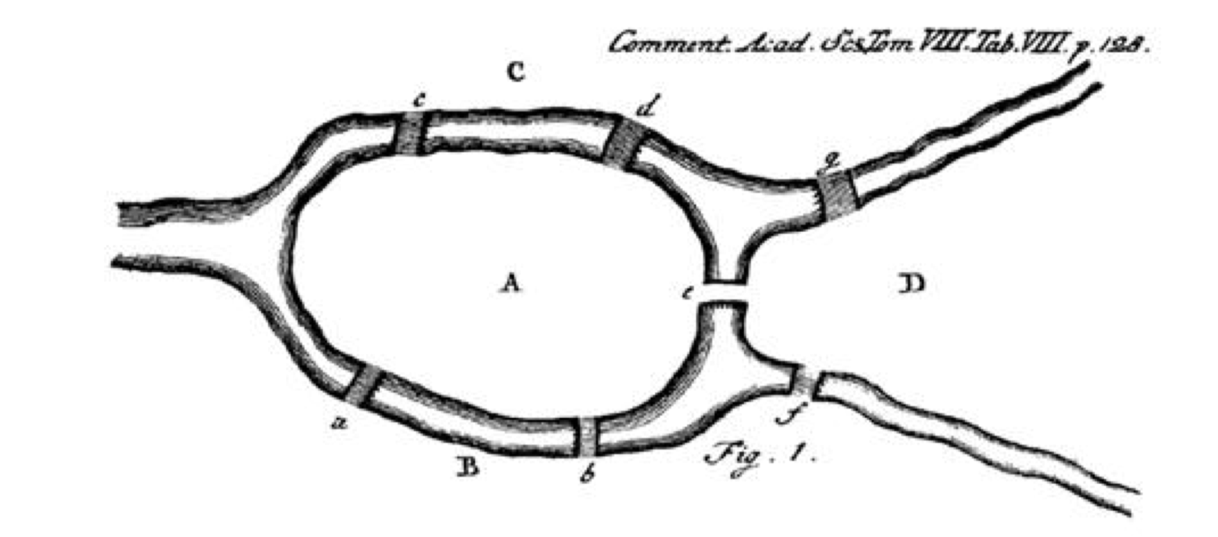
History of Graphs
Graphs – first described by Swiss mathematician Leonhard Euler

Slide 4
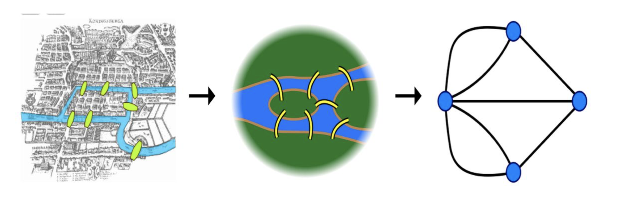
History of Graphs

Slide 5
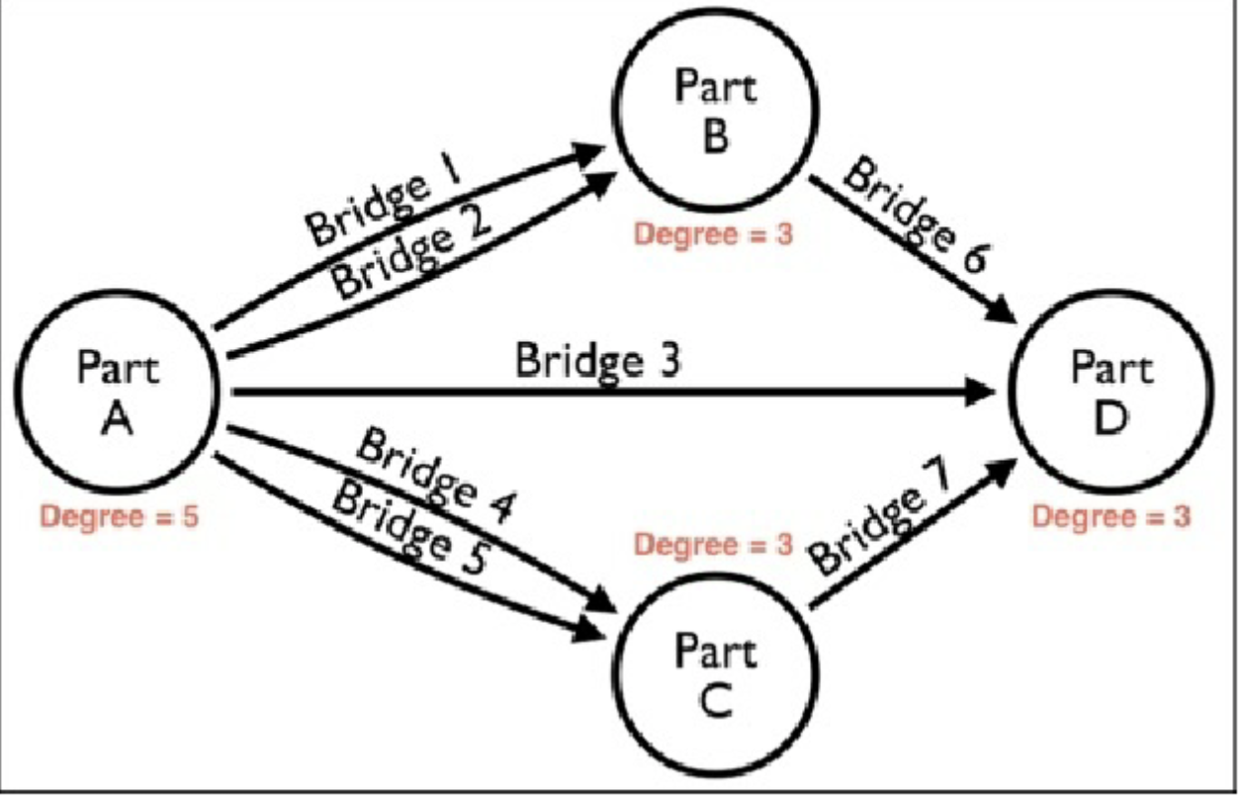
History of Graphs

Slide 6
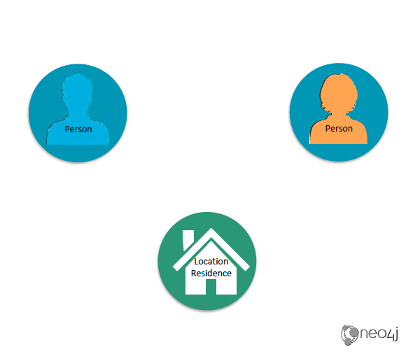
What is a Graph?

Slide 7
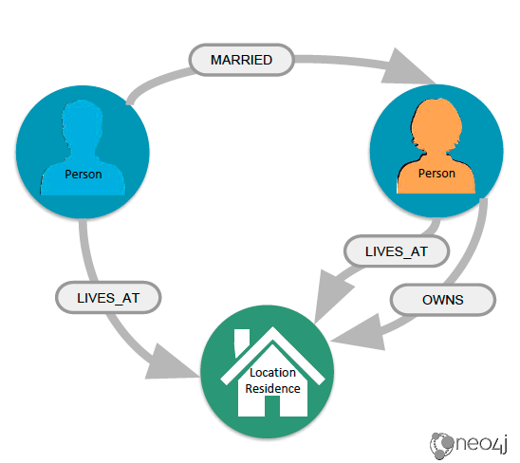
What is a Graph?

Slide 8
What is a Graph?
Nodes – represent things or entities
Cities
Employees in a company
Electrical circuits
Train stations
Have relationships with other vertices
Employees manage other employees
Cities are linked to other cities by highways

Slide 9
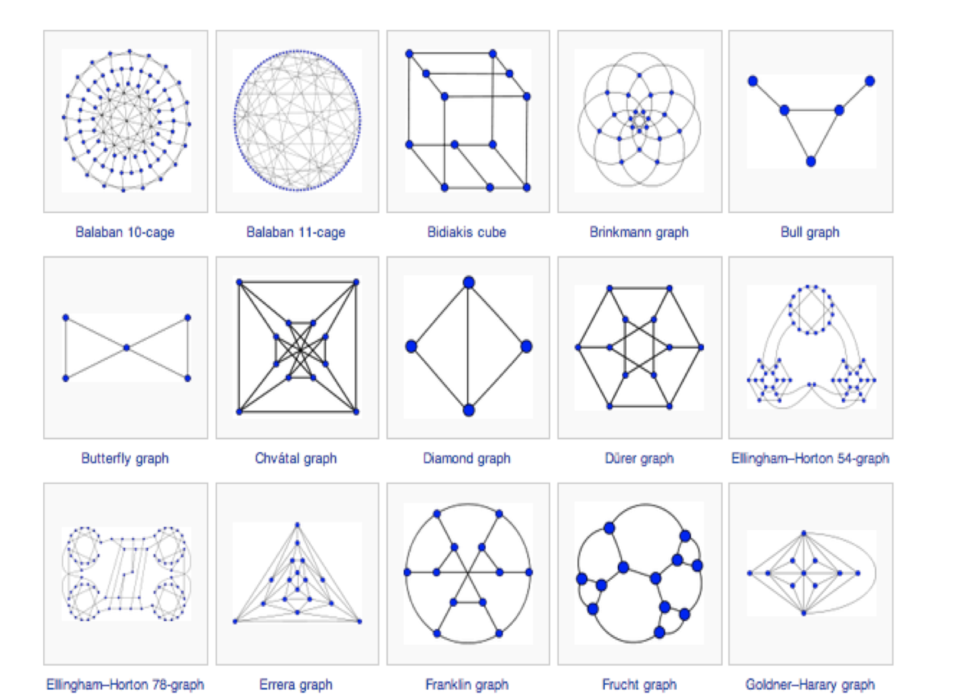
What is a Graph Theory?

Slide 10
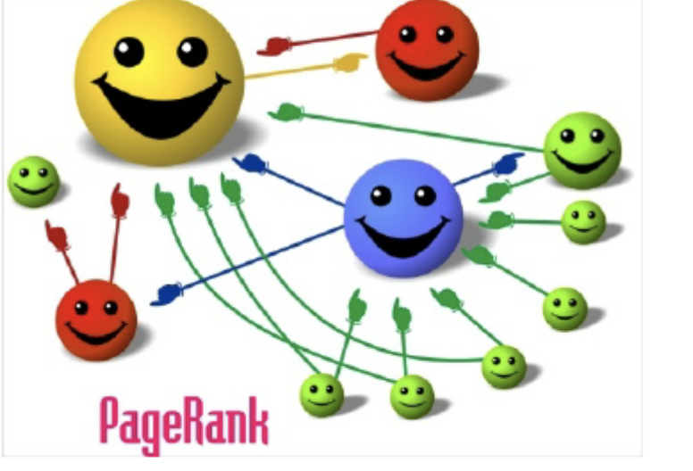
Graphs in Computer Science

Slide 11
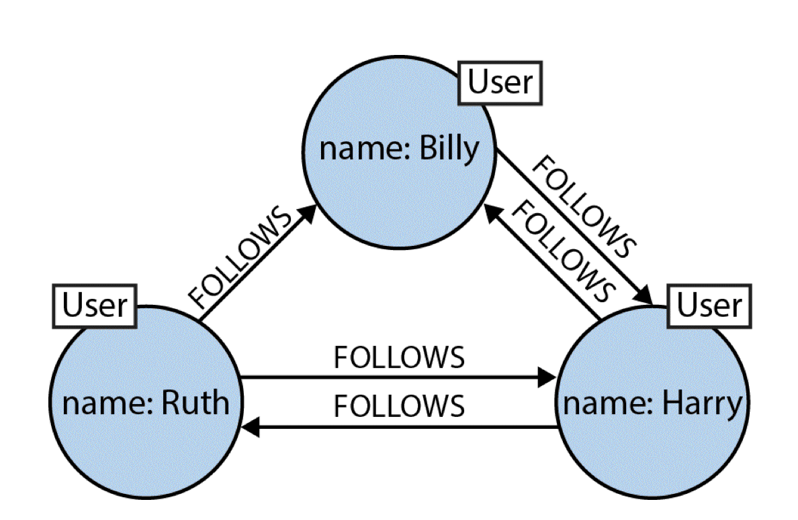
Graphs in Computer Science

Slide 12
Introduction to Graph databases
Graph database – online database management system
Used to model data in a form of graph
Stores data using nodes, relationships and properties
Online database management system with CRUD
Generally built for use with OLTP
Optimized for transactional performance

Slide 13
Introduction to Graph databases
Performance
Performance remains constant as dataset grows
Flexibility
Schema-free, can add nodes, labels, subgraphs at any point
Agility
Evolve data model with the rest of application
Cypher query language for graphs
Less time writing queries
More time asking the next questions about the data

Slide 14
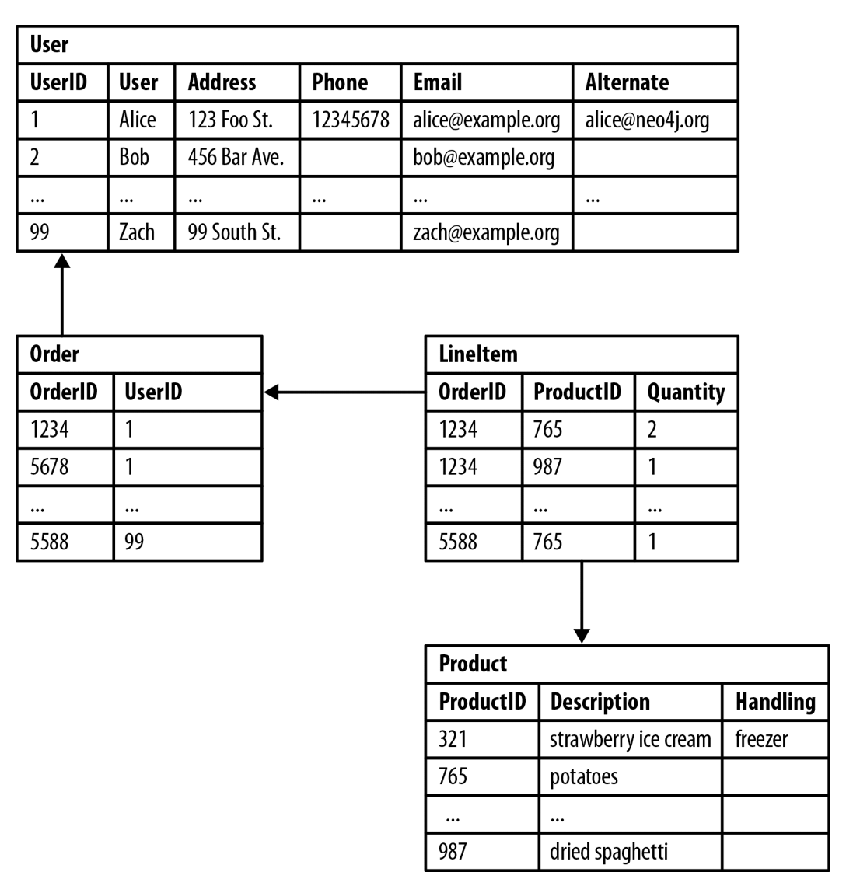
Introduction to Graph databases

Slide 15
Relational databases cannot handle relationships
Model Issues
They cannot model or store relationships without complexity
Degraded Performance
Speed plummets as data grows and as the number of joins grows
Not Flexible
New types of data and relationships require schema redesign

Slide 16
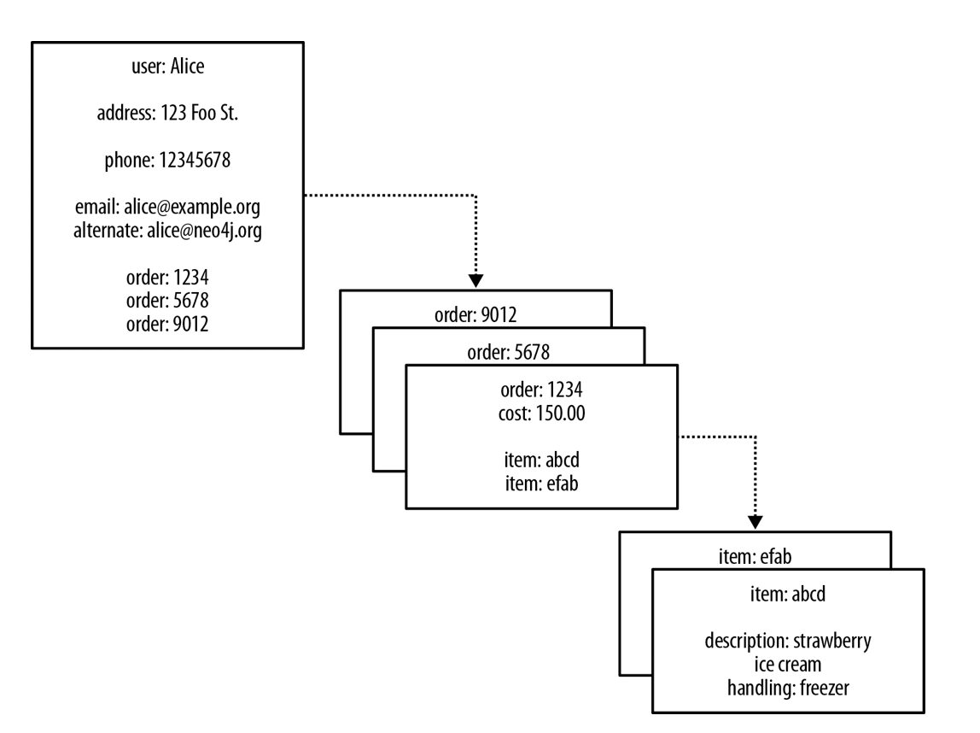
Introduction to Graph databases

Slide 17
NoSQL databases cannot handle relationships
Model Issues
They cannot model or store relationships without complexity
Degraded Performance
Speed plummets as you try to join data together in the application
Wrong Languages
Lots of ”almost SQL” languages not good at joins

Slide 18
What is Graph Database?
Right model
Graphs simplify how you think
Better Performance
Query relationships in real time
Right Language
Cypher was built for graphs
Flexible and Consistent
Evolve your schema seamlessly while keeping transactions (ACID)

Slide 19
Introduction to Graph databases

Slide 20
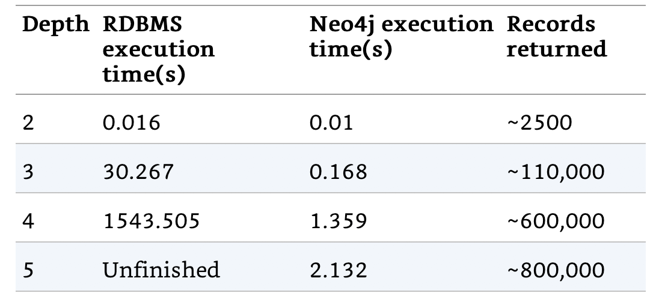
Introduction to Graph databases

Slide 21
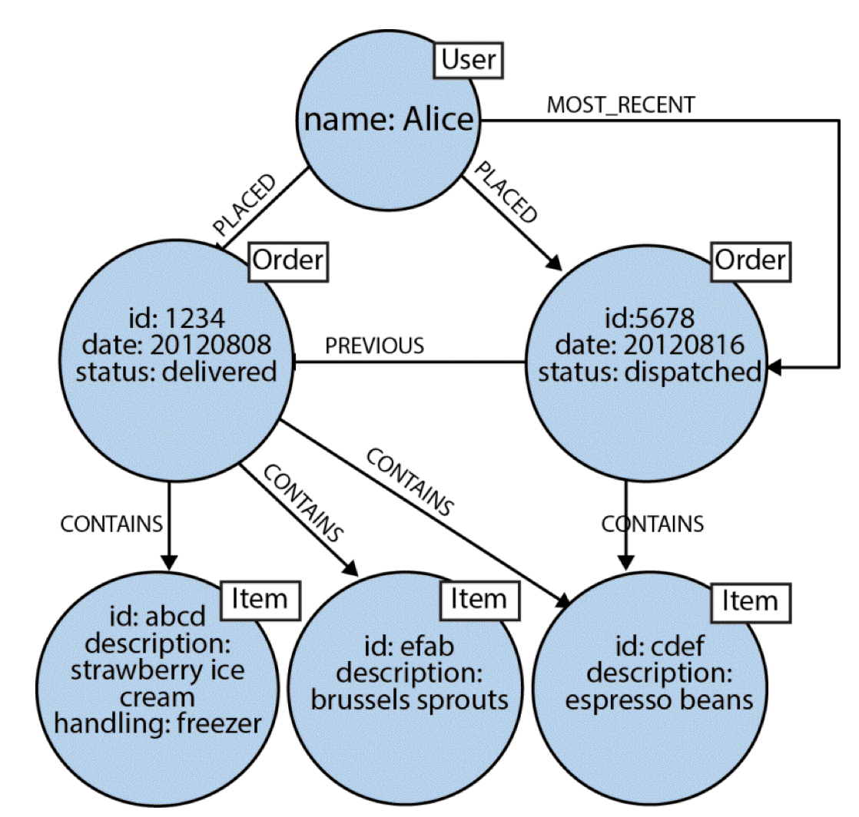
Graph databases vs RDBMS

Slide 22
Graph databases vs RDBMS
Graph Database | RDBMS
Data is stored in graphs | Data is stored in tables
Nodes | Rows
Properties and their values | Columns and data
Connected nodes are defined by relationships | Constraints are used for relationships (PK/FK)
Database traversal | Table joins

Slide 23
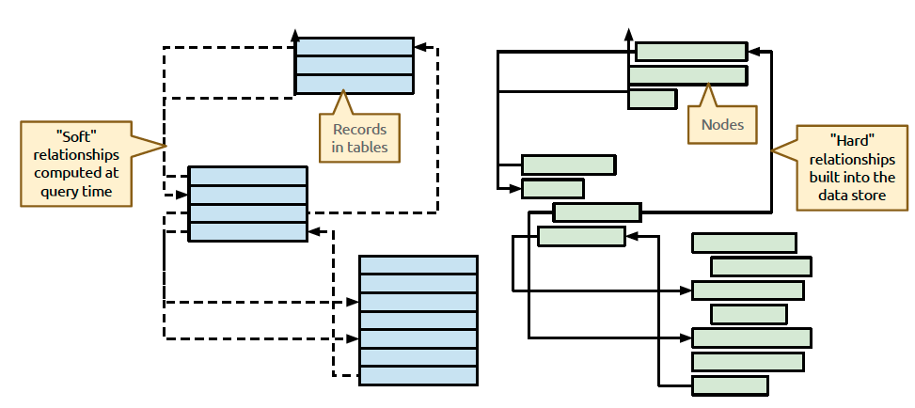
Run-time behavior: RDBMS vs Graph

Slide 24
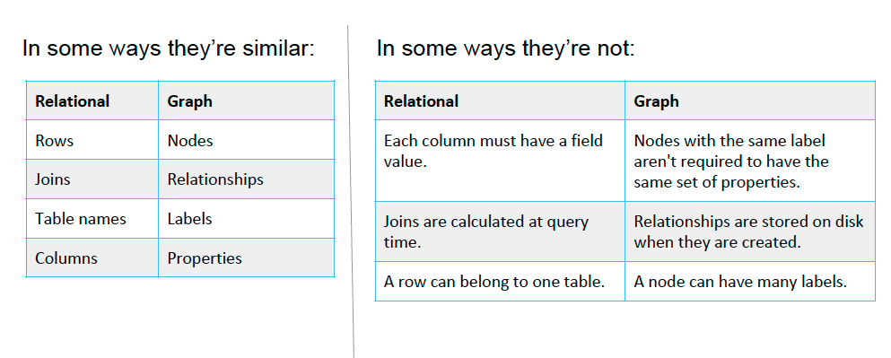
RDBMS vs Graph

Slide 25
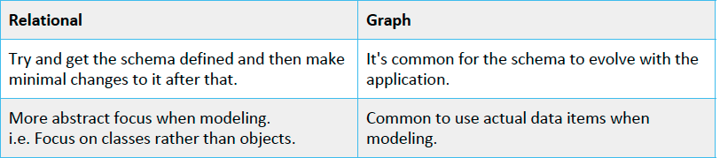
How do we model: RDMBS vs graph

Slide 26
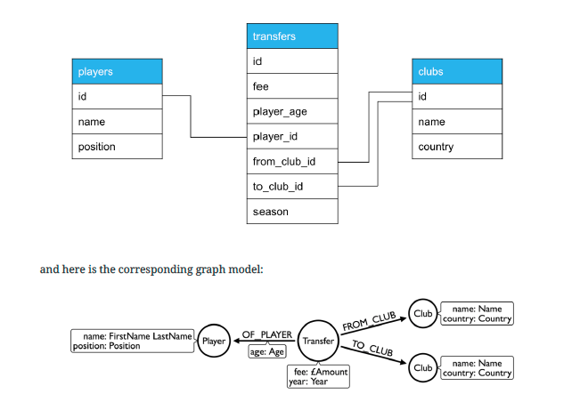

Slide 27
Property Graph Model
Property Graph Model – store data in the graph database
Using vertices and edges (nodes/relationships)
Can represent data in more natural way
Apply graph algorithms

Slide 28
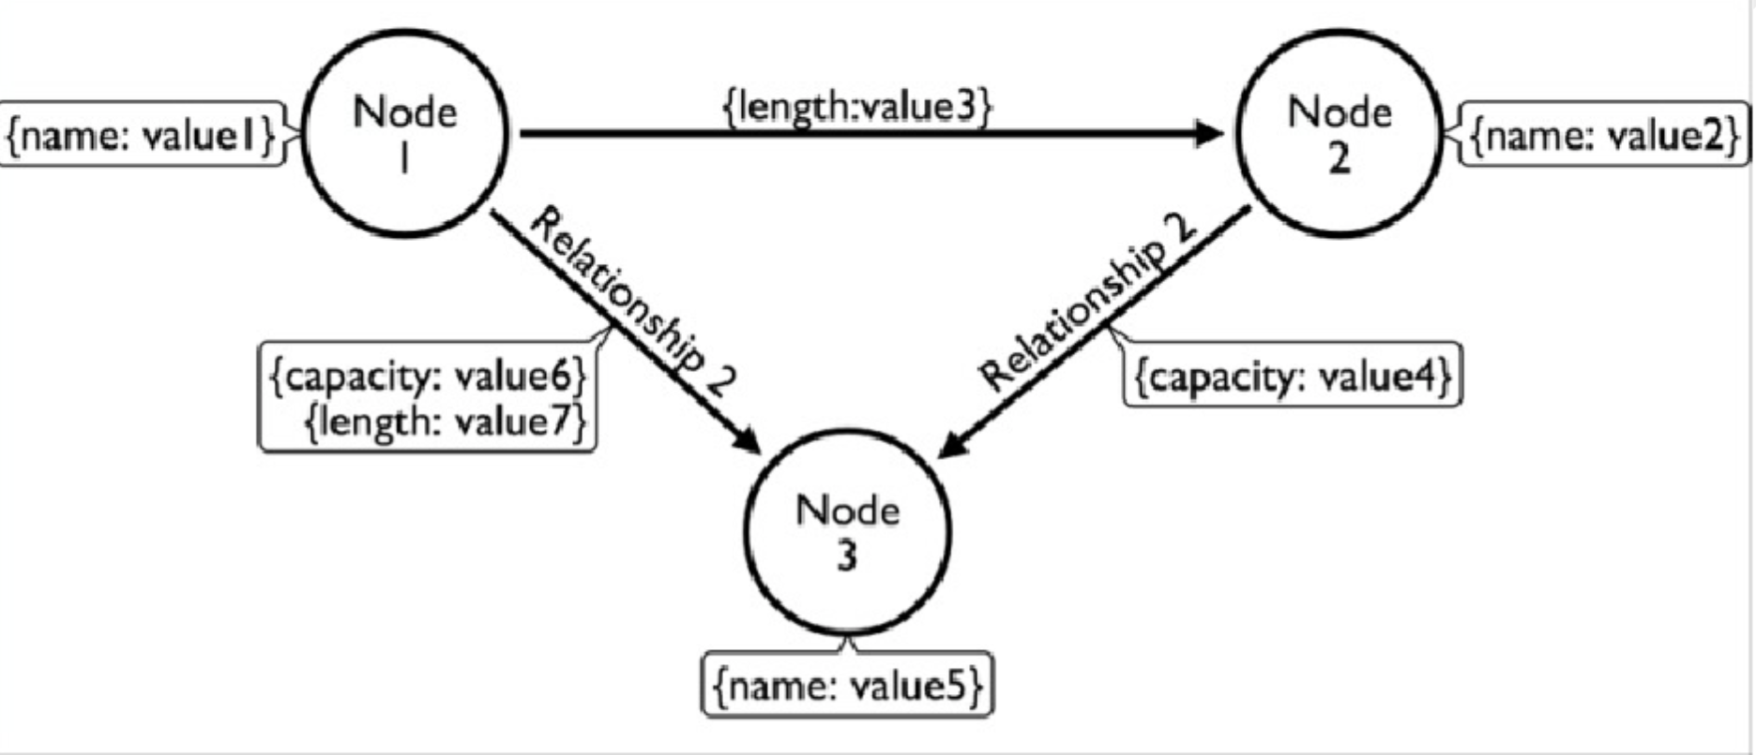
Property Graph Model

Slide 29
Property Graph Model
Relationships are explicit
Not inferred by constraint or established at query time through join operations.
They have the sane expressive power as the nodes representing the entities in the database
Relationships can have properties too
Can have values associated with the that can specify length, capacity or any other characteristic of that relationship

Slide 30
Operations on Graphs
Insert, Read, Update, Delete data
Union of graphs
Combine set of vertices and edges in a graph
Intersection of graphs
Set of vertices and edges that are common to both graphs
Graph Traversal
Process of visiting all vertices in a graph

Slide 31
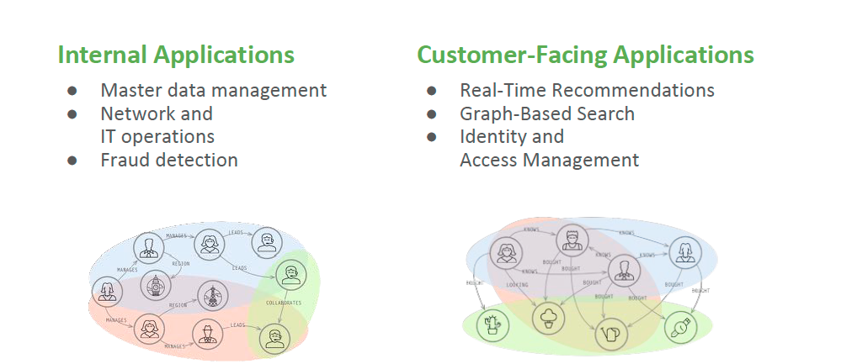
When to Use Graph Databases

Slide 32
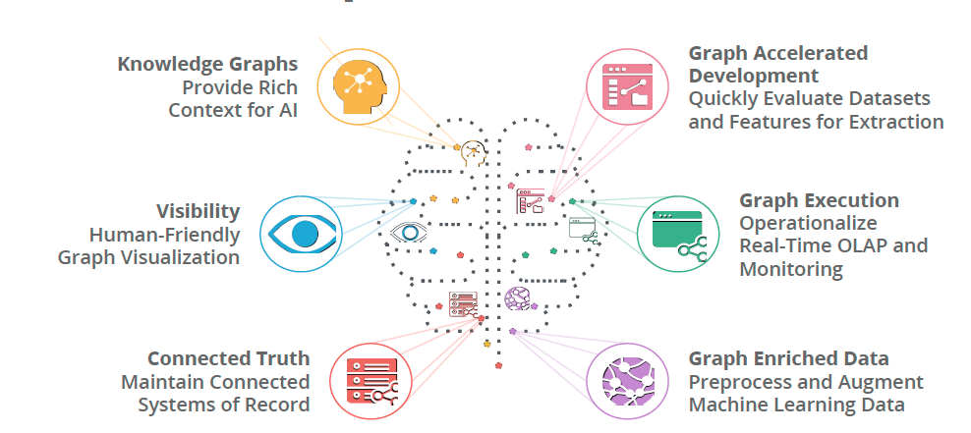
Use case: Graph-based search

Slide 33
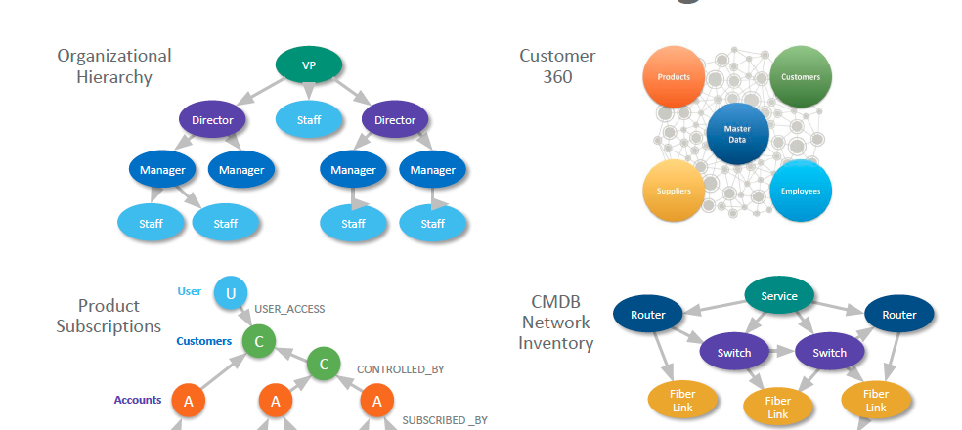
Use case: Master data management

Slide 34
When Not to Use Graph Databases
Large, set-oriented queries
Sets that do not require a lot of joining or require a lot of aggregation
Performance would suffer
Simple, aggregate-oriented queries
Sets that do not require a lot of joining or require a lot of aggregation

Slide 35
Introduction to Neo4j

Slide 36
Introduction to Neo4j
Neo4j is a Database – use it to store information and find it later
Written in Java
Optimized for dealing with graph data
Neo4j’s data model is Labeled Property Graph
Cypher is Neo4j’s query language (SQL for graphs)
Cypher is declarative language – describes what you need, not how to get it
Transactional, ACID-compliant database
Schema is optional (still need design effort!)
Made for online transaction processing

Slide 37
Introduction to Neo4j
Released in 2007, sponsored by Neo4j, Inc
Under active development
Designed to scale
Critical scalability, high availability, fault-tolerance
Clustering solution offers horizontal and vertical scalability
Cypher declarative query language
Pattern matching language
Allows us to state the pattern to be retrieved
Allows for efficient query optimizations
High-performance graph operations

Slide 38
Introduction to Neo4j
Open-source
Critical scalability, high availability, fault-tolerance
Clustering solution offers horizontal and vertical scalability
Community and Enterprise versions
Enterprise gets 24/7 support, clustering, backup
Can install Neo4j community version to explore

Slide 39
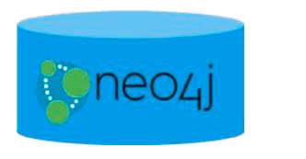
Neo4j Graph Platform
The Neo4j Graph Platform includes components that enable us to develop graph-enabled application.
The heart of the Neo4j Graph Platform is the Neo4j Database

Slide 40
Neo4j Index-free Adjacency
Nodes and relationships are stored on disk as a graph for fast navigational access using pointers
Pre-computed bidirectional join
Traversal is like pointer dereferencing
Almost as fast
Index-free adjacency
Each node maintains a direct link to its adjacent nodes

Slide 41
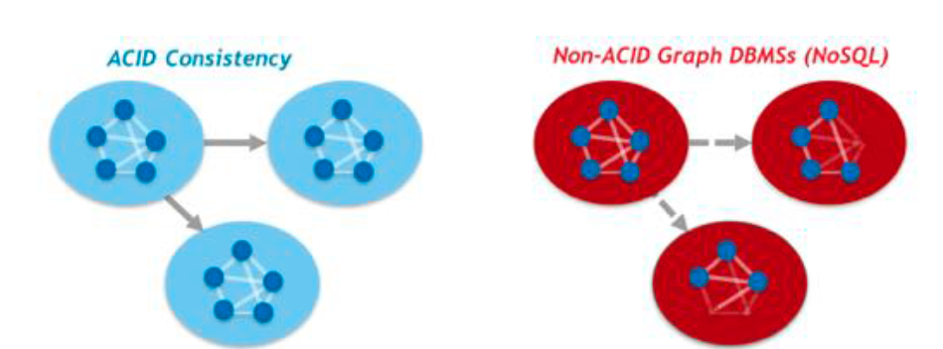
Neo4j Database: ACID
Transactional consistency – all updates either succeed or fail

Slide 42
Graph Engine
Interprets Cypher statements
Store and retrieve data
Kernel-level access to filesystem
Scalable
Performant

Slide 43
Language and driver support
Cypher to access the database
Open source Cypher
You can write server-side extensions to access the database
Out-of-the-box drivers to access the database via bolt protocol:
Java, JavaScript, Python, C#, Go
Neo4j community contributions for other languages

Slide 44
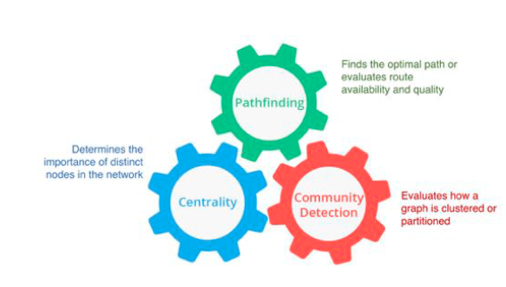
Libraries
Out-of-the-box:
Awesome Procedures on Cypher (APOC)
Graph Algorithms
GraphQL

Slide 45
Tools
Neo4j Desktop
Neo4j Browser
Neo4j Bloom
Neow4j ETL Tool

Slide 46
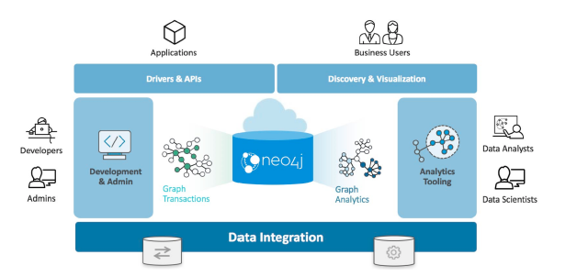
Neo4j Graph Platform Architecture

Slide 47
Neo4j Data Model – 4 data constructs
Nodes
Used to store entity information.
Relationships
Connect nodes to one another – provide means of structuring entities
Properties
Nodes and relationships are containers for properties (name/value pairs)
Labels
Categorize graphs – create subgraphs

Slide 48
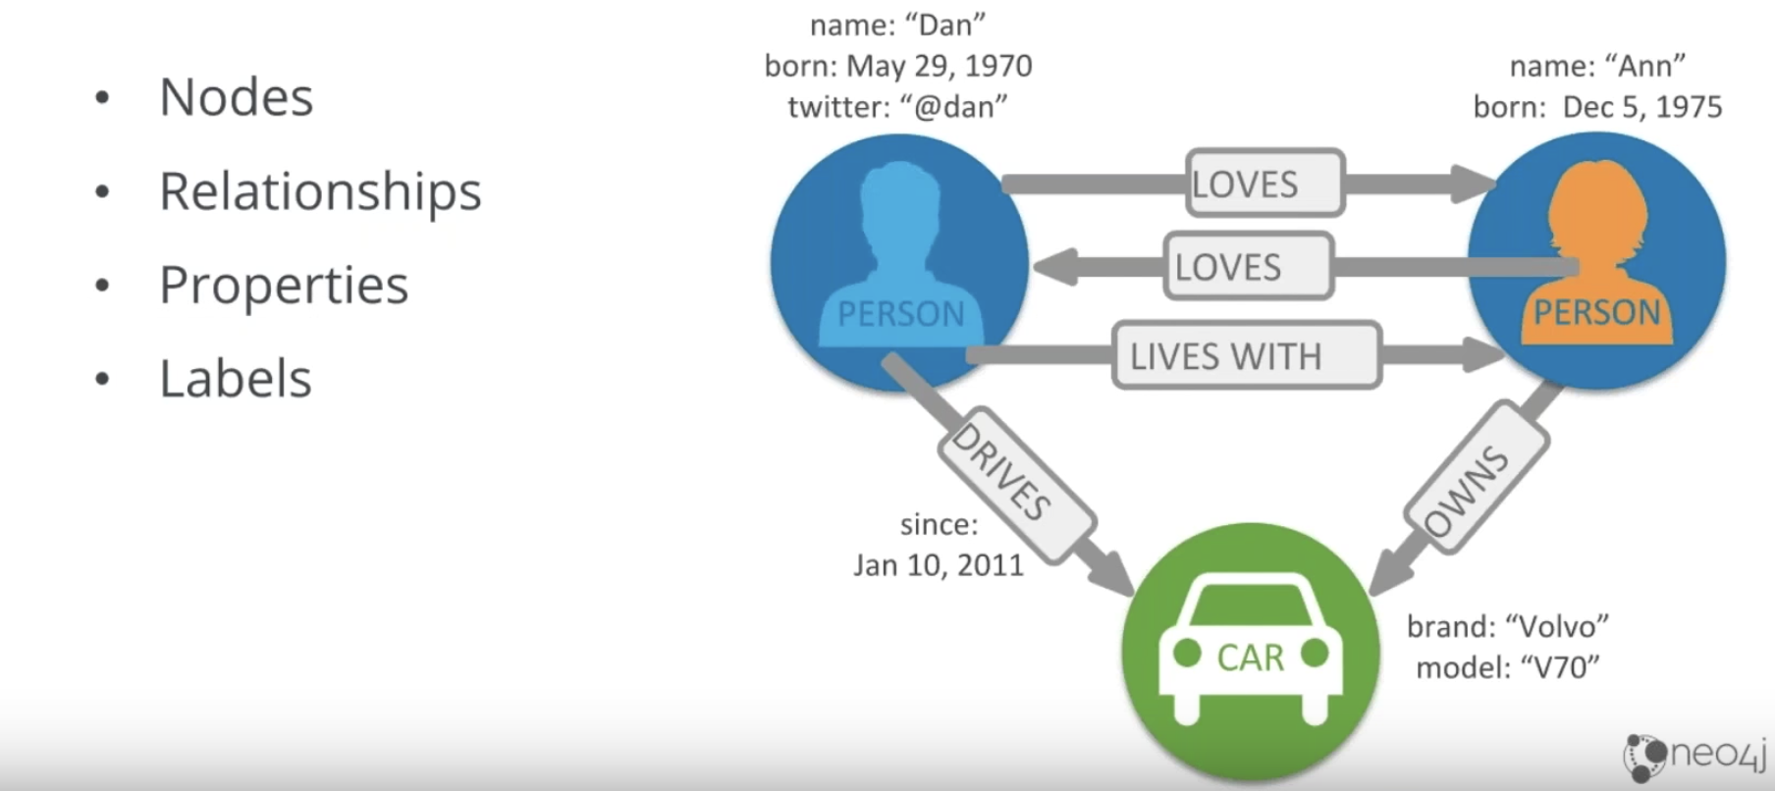
Neo4j Labelled Property Graph Model

Slide 49
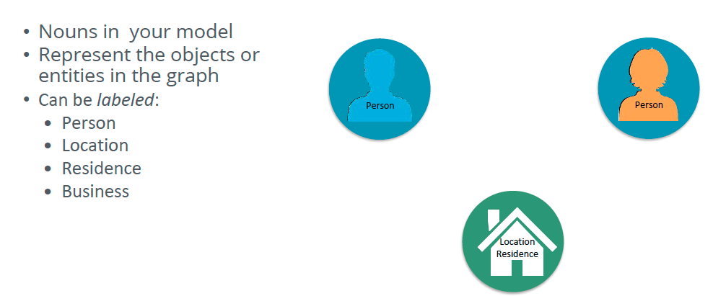
Nodes

Slide 50
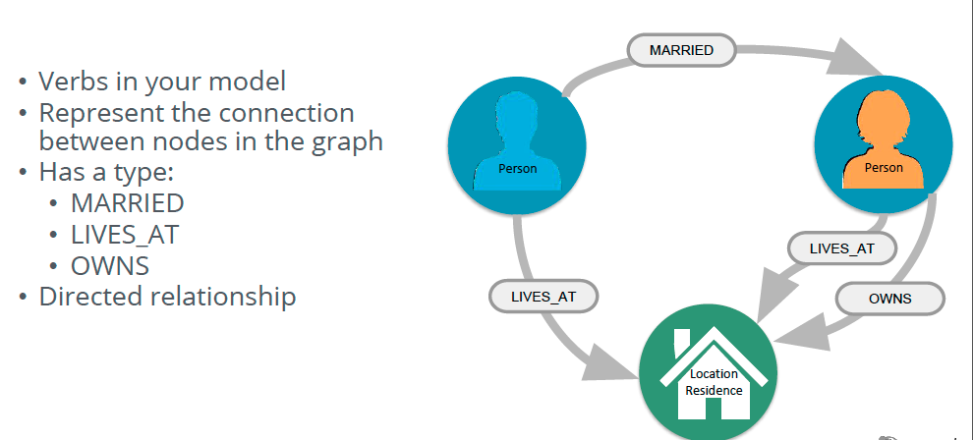
Relationships

Slide 51
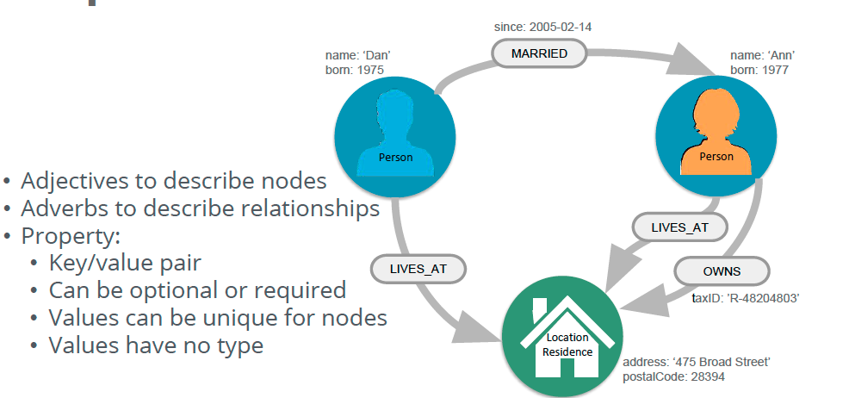
Properties

Slide 52
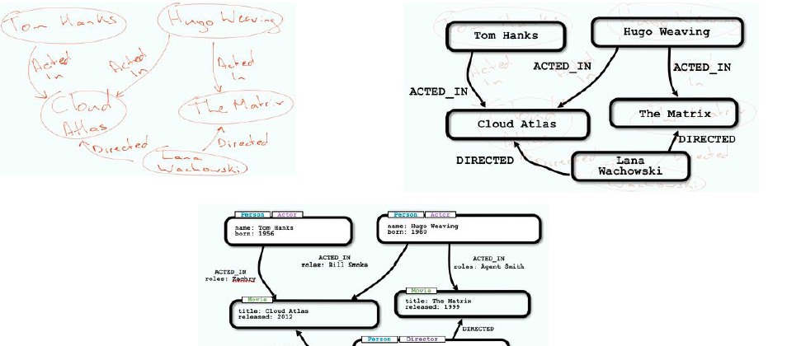
Neo4j Graph Modeling

Slide 53
Neo4j Data Model
Identify nodes in the graph (entities)
What properties are important?
Identify unique IDs
Identify all of the connections (relationships)
Repeat the process
Based on the type of questions we want to ask of our data
http://www.apcjones.com/arrows/

Slide 54
Neo4j Data Model
Design for query-ability:
Queries will drive the model
Start with user stories
Aligning relationships with use cases:
Use different relationship types between nodes for different use cases
Keep naming strategy for your relationship types

Slide 55
Neo4j Data Model – Indexes
Graphs are their own indexes!
Unless we want shortcuts to specific nodes
We can index in code
Add more flexibility
Indexes trade read performance for write cost
Just like any database, including RDBMS

Slide 56
Query Neo4j
Query it with
Cypher from Neo4j Browser
Cypher from Java
Rest API
Rest API using Cypher query
Programmatically
Gremlin

Slide 57
What is Cypher?
Cypher – SQL for Graphs
Declarative query language
Focuses on what, not how to retrieve
Uses keywords such as MATCH, WHERE, CREATE
Runs in the database server for the graph
ASCII art to represent nodes and relationships

Slide 58
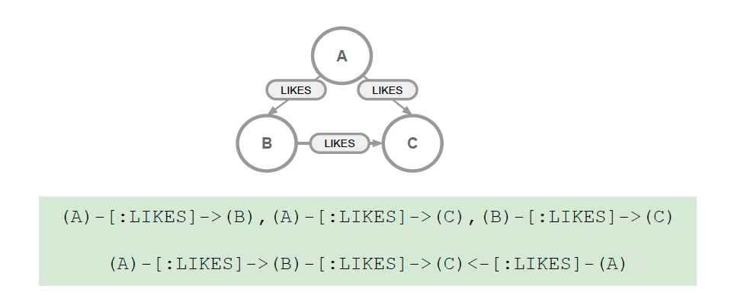
What is Cypher?

Slide 59
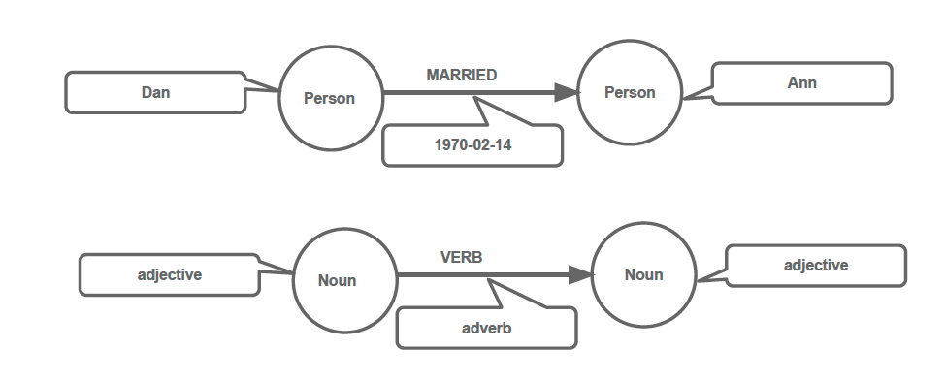
What is Cypher?

Slide 60
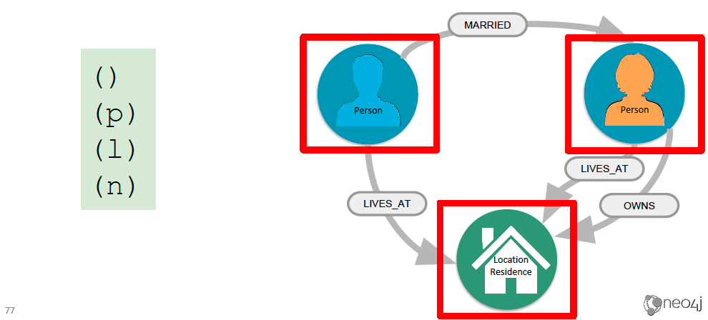
Nodes

Slide 61
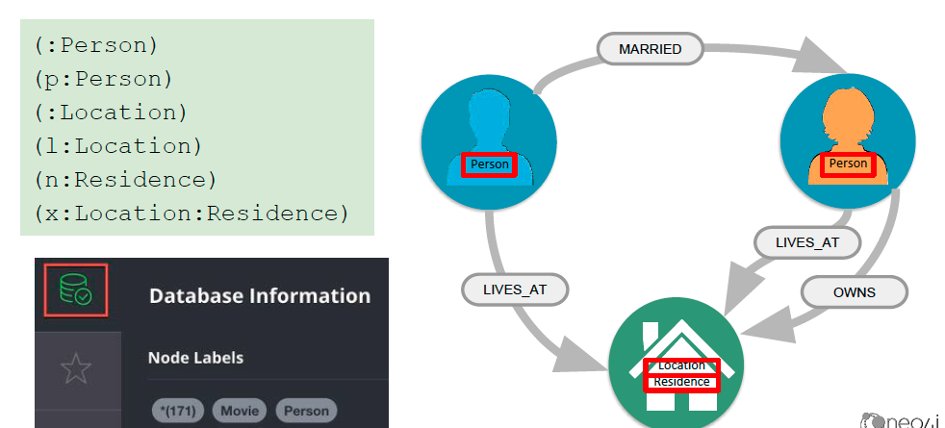
Labels

Slide 62
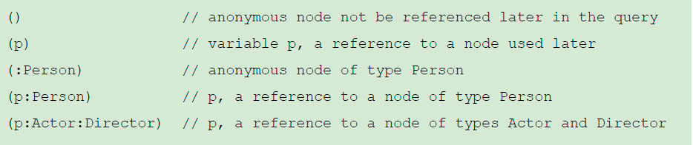
Comments in Cypher

Slide 63
Data Model

Slide 64
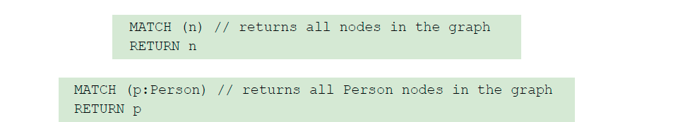
Using MATCH to retrieve nodes
Composed of clauses
Simplest queries consist of MATCH clause followed by RETURN clause

Slide 65
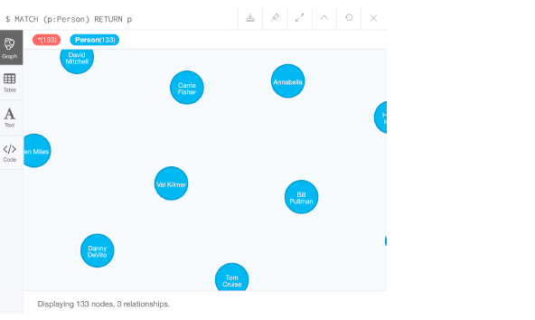
Using MATCH to retrieve nodes

Slide 66
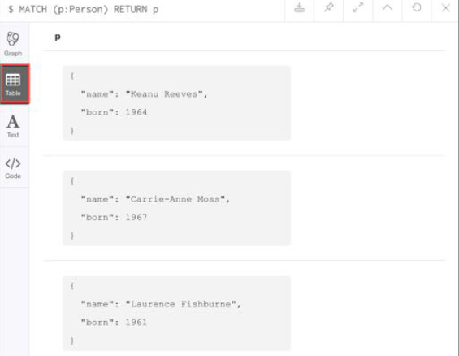
View nodes as table data

Slide 67
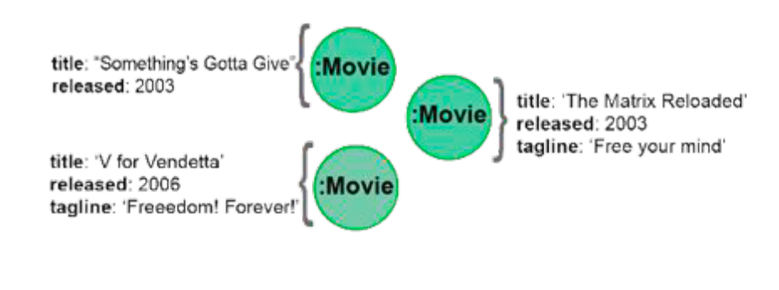
Properties

Slide 68
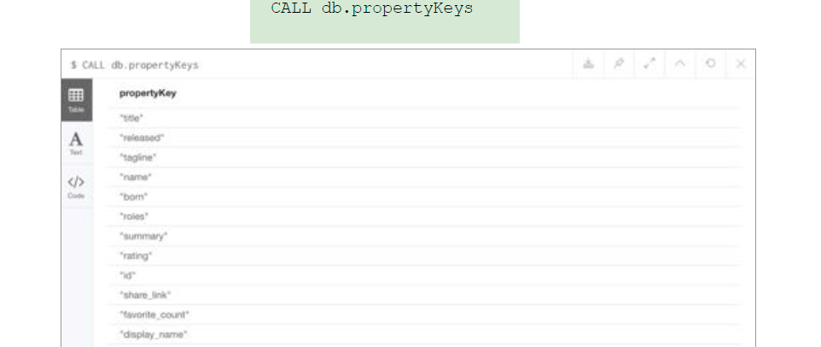
Property Keys

Slide 69
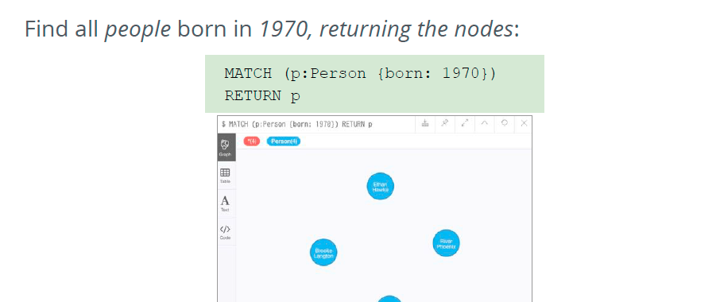
Retrieving nodes filtered by property value

Slide 70
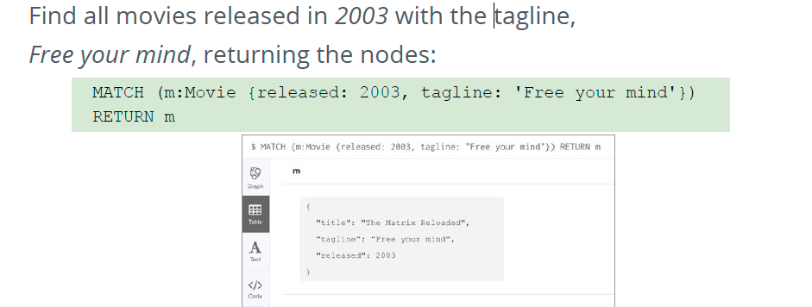
Retrieving nodes filtered by property value

Slide 71
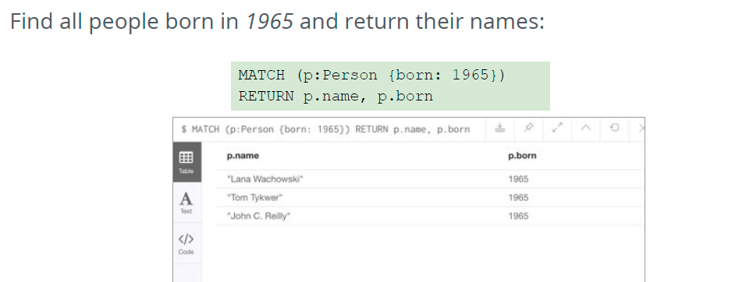
Returning Property Values

Slide 72
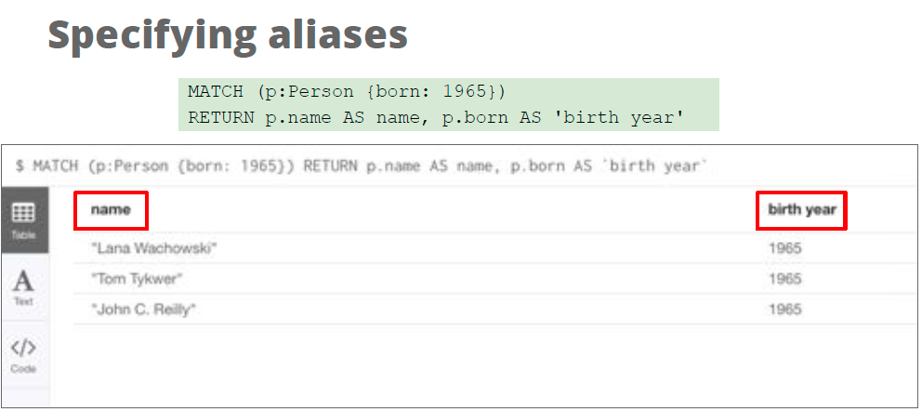
Specifying aliases

Slide 73
Using Neo4j Database (lab)
Neo4j Desktop
Create local databases
Manage multiple projects
Start Neo4j Browser instances
Install plugins (libraries) for use with a project
OS X, Linux, Windows

Slide 74
Using Neo4j Database (lab)
Neo4j Sandbox
Web browser access to Neo4j Database server and Neo4j database in the cloud
Comes with blank or pre-populated database
Temporary access
Save Cypher scripts for use in other sandboxes or Neo4j projects
Instance lives for up to 10 days
No need to install Neo4j on your machine

Slide 75
Using Neo4j Browser (lab)
Tool that enables access to Neo4j database
Executes Cypher statements (create or update data in the graph)
Query graph to return data
Returned data is visualized as nodes and relationships, but can also be displayed as tables
Two ways to use Neo4j Browser functionality:
Local Neo4j Desktop (database is local)
Neo4j Browser Web interface by specifying URL using port 7474 (database is local or in the cloud)

Slide 76
Neo4J LAB 1

Slide 77
Sources
“Learning Neo4j”
“NoSQL For Mere Mortals”
”Graph databases: New Opportunities for Connected Data”
“Graph Databases for Beginners”
”Neo4j for Beginners”

